Slide 1


Statistical Modelling with Data
May 23 – June 02, 2023
Instructor: Qing (Leah) Li, Ph.D. Candidate at Cumming School of Medicine
qing.li2@uclagary.ca
Thank you Dr. Thuntida Ngamkham for contributing the contents
Thank you Dr. Qingrun Zhang and Dr. Quan Long for contributing some slides

Slide 2
Statistical Modelling with Data
Topic 1: Statistical Modelling
Lecture 1: First-order models with quantitative independent variables
Topic 2: Statistical Modelling with interactions (Assignment 1)
Lecture 2: Interaction effects, quantitative and qualitative variables
Lecture 3: Interaction effects and second-order models
Topic 3: Statistical Model selection (Assignment 2)
Lecture 4: Model selection: Stepwise regression, Forward selection and Backward Elimination
Lecture 5: Model selection: Evaluate the reliability of the model chosen
Topic 4: Statistical model diagnostics
Lecture 6: Multiple regression diagnostics: verify linearity, independence, and equal variance assumptions.
Lecture 7: Multiple regression diagnostics: verify normality assumptions and identify multicollinearity and outliers.
Lecture 8: Multiple regression diagnostics: data transformation
Topic 5: Transfer learning
Lecture 9: Transfer-learning (Bonus): standing on the shoulders of giants.

Slide 3
Statistical Modelling with Data
Topic 1: Statistical Modelling
Lecture 1: First-order models with quantitative independent variables
Topic 2: Statistical Modelling with interactions (Assignment 1)
Lecture 2: Interaction effects, quantitative and qualitative variables
Lecture 3: Interaction effects and second-order models
Topic 3: Statistical Model selection (Assignment 2)
Lecture 4: Model selection: Stepwise regression, Forward selection and Backward Elimination
Lecture 5: Model selection: Evaluate the reliability of the model chosen
Topic 4: Statistical model diagnostics
Lecture 6: Multiple regression diagnostics: verify linearity, independence, and equal variance assumptions.
Lecture 7: Multiple regression diagnostics: verify normality assumptions and identify multicollinearity and outliers.
Lecture 8: Multiple regression diagnostics: data transformation
Topic 5: Transfer learning
Lecture 9: Transfer-learning (Bonus): standing on the shoulders of giants.
Notes:
The first lecture does not frighten you. I hope you can still bare with my English with accents for the rest of courses.
Many I ask some of your feedbacks for yesterday’s courses? You know these courses won’t be graded and all we ask is to attend six lectures to get the certificate. However, there must be something more than certificate you want to get from this course. I hope that I can really help you understand some basics of statistical modelling. I am not sure what’s your exceptions from this course.

Slide 4
Statistical Modelling with Data
Learning Outcomes: At the end of the course, participants will be able to
Model the multiple linear relationships between a response variable (Y) and all explanatory variables (both categorical and numerical variables) with interaction terms. Interpret model parameter estimates, construct confidence intervals for regression coefficients, evaluate model fits, and visualize correlations between a response variable (Y) and all explanatory variables (X) by graphs (scatter plot, residual plot) to assess model validity.
Predict the response variable at a certain level of the explanatory variables once the fit model exists.
Implement R-software and analyze statistical results for biomedical and other data.
Evaluations
Assignments will be posted on Slack (our communication tool with students).
Students must attend 70% (6/9) of the sessions in order to receive the certificate and are encouraged to work on the assignments progressively throughout the course as the relevant material is covered.

Slide 5

Statistical Modelling with Data
Supportive materials
Lectures slides (2023)
R code scripts (2023)
PDF (dated 2022)
Two Assignments (dated 2022)
Slack channels
Recoding videos
Exercises
Course-documents

Slide 6
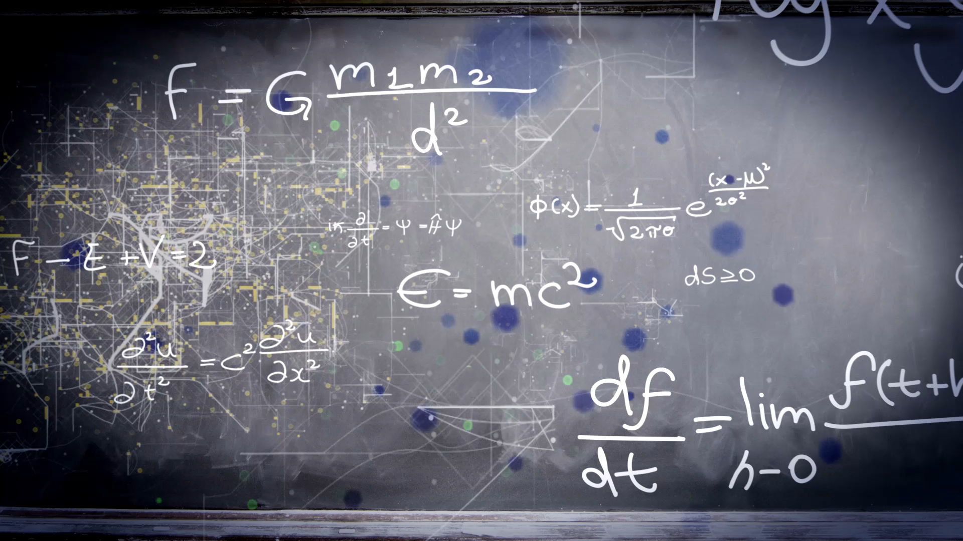
Lecture 4: Model Selection
Notes:
I will change the style a bit as I decide to solve in class practice problem with you together. So we can go over all R functions we have studied so far. You will see how to use them to solve real-life problems.

Slide 7
Quick recap of lecture 3
Statistics:
Interaction Effect in Multiple Regression with both Quantitative and Qualitative (Dummy) Variable models
Two different approaches but result in the same optimal model
A Quadratic (Second Order) Model with Quantitative predictors
Cross validation to avoid overfitting and underfitting model
Code:
lm(y ~ x1+x2+(x1+x2)^2 + I(X1^2)+I(X2^2))
CVlm()

Slide 8
Model Selection
Stepwise model selection methods
Backwards Elimination
Forward Selection
Stepwise regression
Criteria for model selection
p-values
adjusted R²
RMSE
Mallows’s Cp Criterion
AIC (Akaike’s information criterion)

Slide 9
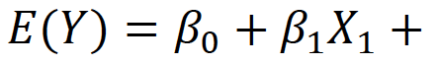
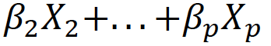
Backward Elimination Procedure
Step 1: The Backward procedure initially fits a model containing terms for all potential independent variables
Step 2: The variable with the smallest t (or F) test statistic (largest p-value) for testing 𝐻0:𝛽𝑖=0 is identified and dropped from the model if the t-value is less than some specified critical value or p-value more than a cut-off (common: 0.3)
The model with the remaining (𝑝−1) independent variables is fit in step 2, and again, the variable associated with the smallest nonsignificant t-value (largest p-value) is dropped. This process is repeated until no further nonsignificant independent variables can be found.

Slide 10
Backward Elimination Procedure
Dr. Thuntida Ngamkham’s approach
Build an additive model
Determine significant predictors
Build an interaction model with significant predictors
Remove non-significant interactions
Rerun model to ensure all predictors are significant
Iterate at step 5 until done
Leah’s approach:
Start with an interaction model with all predictors
Remove non-significant interactions
Rerun model to ensure all predictors are significant
Iterate step 3 until done.
Similar to backward elimination. But backward elimination is more rigorous as it only remove one predictor at a time
10
Notes:
Here I listed pros and cons for these two approaches.
Know you know each approach to build a model with quantitative and qualitative variables and you also know their strengths and drawbacks. You can decided which one to use at your end.

Slide 11
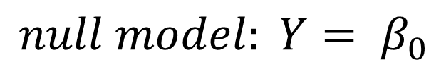
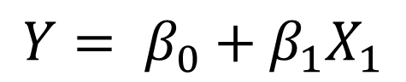
Forward selection
Do a similar thing like a backward selection but the other way around.
Step 1: The software program fits all possible one-variable models of the form. The independent variable that produces the largest (absolute) t -value (smallest p-value) is then declared the best one-variable predictor of 𝑌. Call this independent variable 𝑋₁.
$$null model: Y= β_{0}$$
$$Y= β_{0}+β_{1}X_{1}$$
11

Slide 12
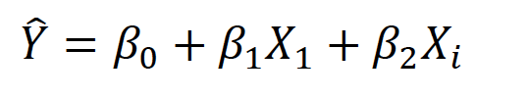
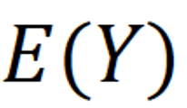
Forward selection
Step 2: The stepwise program now begins to search through the remaining (𝑝−1) independent variables for the best two-variable model of the form
This is done by fitting all two-variable models containing 𝑋₁ and each of the other (𝑝−1) options for the second variable 𝑋_{𝑖}. The t-values for the test 𝐻₀:𝛽₂=0 are computed for each of the 𝑝−1 models (corresponding to the remaining independent variables, 𝑋_{𝑖},𝑖=2,3,...,𝑝−1), and the variable having the largest 𝑡 is retained. Call this variable 𝑋₂.
Repeat this step 2 until the model go through all predictors
12

Slide 13
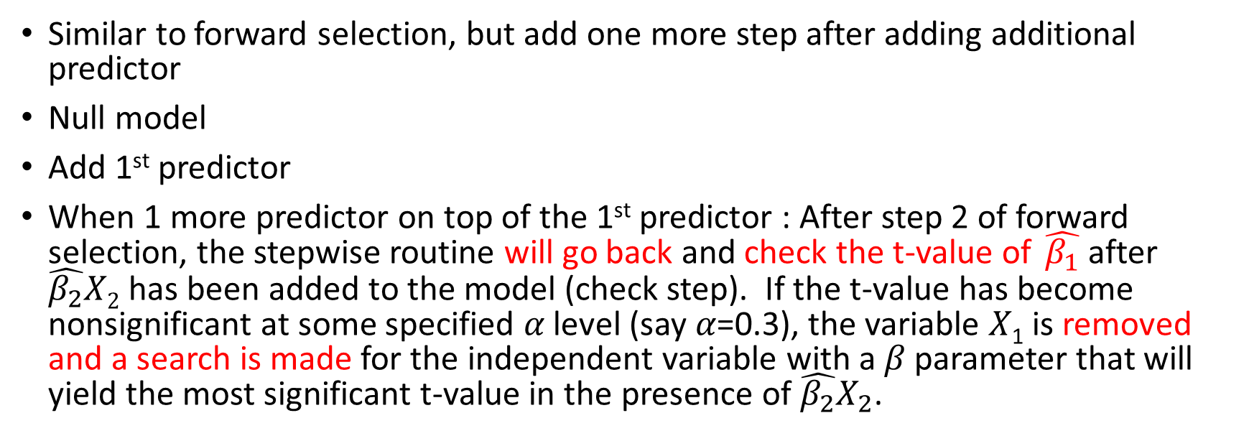
Stepwise Regression
Similar to forward selection, but add one more step after adding additional predictor
Null model
Add 1st predictor
When 1 more predictor on top of the 1st predictor : After step 2 of forward selection, the stepwise routine will go back and check the t-value of $\hat{β_{1}}$ after $\hat{β_{2}}X2$ has been added to the model (check step). If the t-value has become nonsignificant at some specified 𝛼 level (say 𝛼=0.3), the variable 𝑋₁ is removed and a search is made for the independent variable with a 𝛽 parameter that will yield the most significant t-value in the presence of $\hat{β_{2}}X_{2}$.
13

Slide 14
Comparisons of three approaches
To test whether a predictor can be added/removed from the model:
 | STEP1 | STEP2 | STEP3
Backward elimination | The optimal model (Start from Full model) | Identify the predictor with largest p-value and remove it predictor if its p-value is larger than a threshold in anova (f-test). | NA
Forward selection | The optimal model (Start from Y ~ 1) | Identify the predictor with smallest p-value its p-value is smaller than a threshold in t-test. | NA
Stepwise regression | The optimal model (Start from Y ~ 1) | Identify the predictor with smallest p-value its p-value is smaller than a threshold in t-test. | Check the p-value for predictors before adding the new predictor, replace it if its p-value is no longer significant after adding the new predictor.

Slide 15


In class Practice Problem 10
Use the Executive Salary (EXECSAL2.csv) data.
Use backward elimination to identify potentially important predictor variables (make sure to specify which are qualitative).
Use forward selection to identify potentially important predictor variables. Are they the same as backward elimination?
Use stepwise selection to identify potentially important predictor variables. Are they the same as previous two methods?
Lecture_4.R

Slide 16
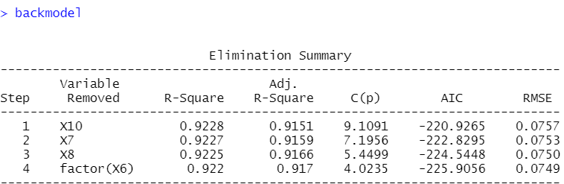
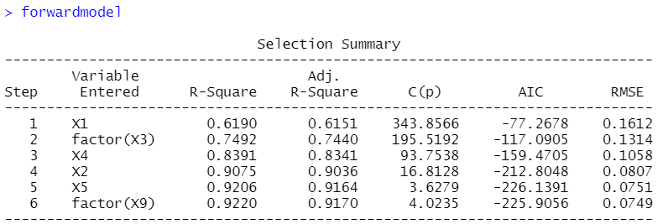
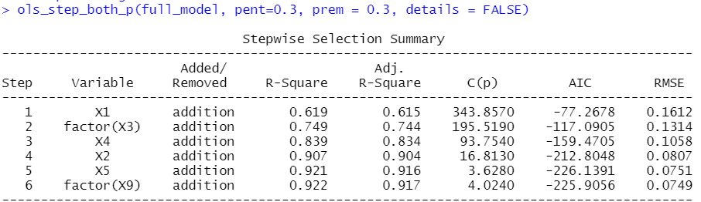
In class Practice Problem 10
Save you day with “olsrr” package!
olsrr: Tools for Building OLS Regression Models
>backmodel=ols_step_backward_p(fullmodel, prem = 0.3, details=TRUE)
>forwardmodel=ols_step_forward_p(fullmodel, penter = 0.3, details=TRUE)
>stepwisemodel=ols_step_both_p(fullmodel, pent = 0.3, prem=0.3, details=TRUE)
Lecture_4.R
Notes:
Do they appear familiar to you?

Slide 17

In class Practice Problem 11
Use the CREDIT.CSV data.
Use backward elimination to identify potentially important predictor variables (make sure to specify which are qualitative).
Use forward selection to identify potentially important predictor variables.
Are the results the same?
Lecture_4.R
17

Slide 18
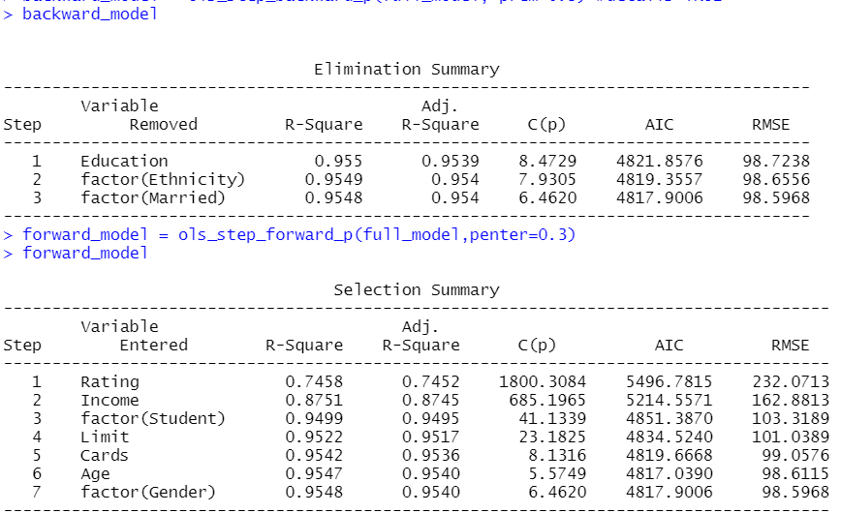
In class Practice Problem 11
backward_model=lm(Balance ~ Income+Limit+Rating+Cards+Age+factor(Gender)+factor(Student), data=credit)
forward_model=lm(Balance ~ Rating+Income+Factor(student)+Limit+Cards+Age+factor(Gender), data=credit)
Lecture_4.R
18

Slide 19
In class Practice Problem 12
Use the CREDIT.CSV data.
Use stepwise regression to find the potentially important independent variables for predicting credit card balance. (make sure to specify which are qualitative).
Is the result the same as the previous two approach?
Lecture_4.R
19

Slide 20
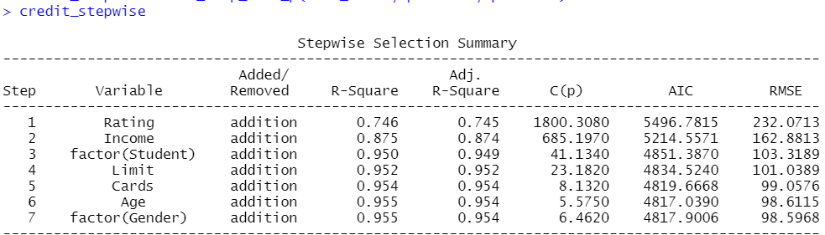
In class Practice Problem 12
stepwise_model=lm(Balance ~ Rating+Income+factor(student)+Limit+Cards+Age+factor(Gender), data=credit)
forward_model=lm(Balance ~ Rating+Income+factor(student)+Limit+Cards+Age+factor(Gender), data=credit)
Lecture_4.R
20

Slide 21

Coffee break
This Photo by Unknown Author is licensed under CC BY-SA
Notes:
"It's time for a break!"
"Let's take a moment to relax and recharge."
"Enjoy your break!"
"Take this opportunity to unwind and refresh."
"We've worked hard, now it's time to take a breather."
"Let's step away from our tasks for a little while."
"Use this break to stretch, grab a snack, or do something enjoyable."
"Take a well-deserved break and come back feeling rejuvenated."
"Pause for a moment and give yourself a chance to rest."
"Take this break to clear your mind and come back with renewed focus.“
"Welcome back, everyone!"
"I hope you enjoyed your break. Let's get back to work."
"I hope you're feeling refreshed and ready to dive back in."
"Alright, let's pick up where we left off before the break."
"I hope the break provided the energy boost we needed. Let's continue our progress."
"I'm glad to see everyone back. Let's resume our tasks."
"I hope you had a productive break. Now let's continue with our work."
"Let's refocus and get back into the flow of things."
"Welcome back, team! Let's make the most of our time remaining."
"I trust everyone had a rejuvenating break. Now let's hit the ground running.“

Slide 22
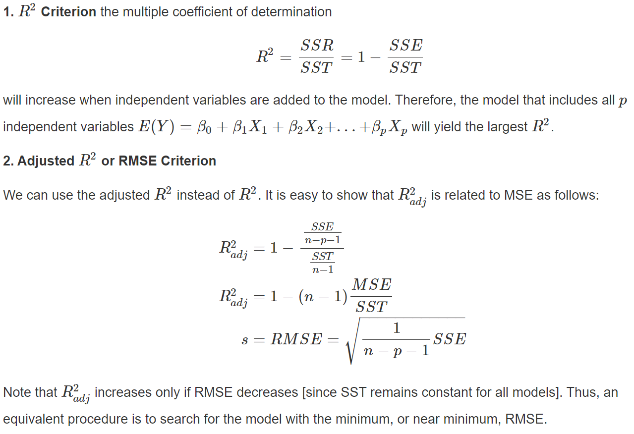
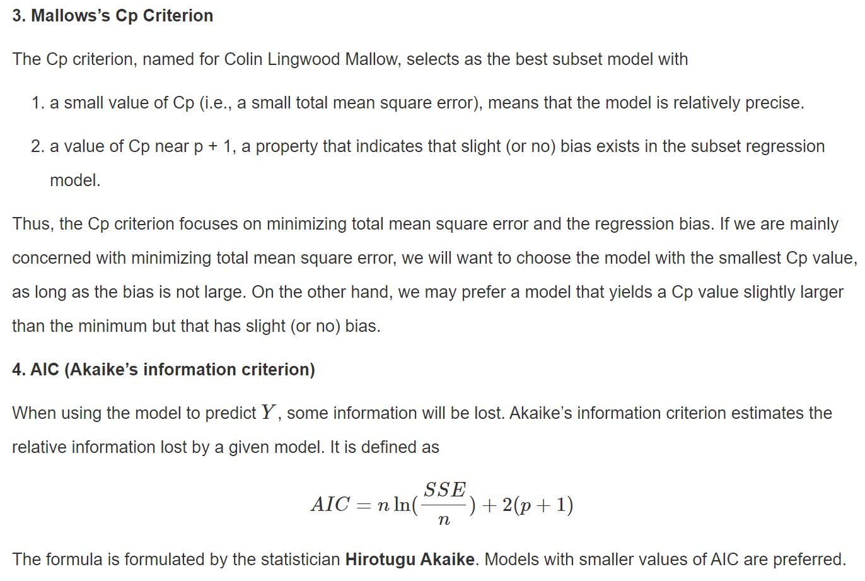
All Possible Regressions Selection Criteria
Adjusted based on the number of predictors
Hen, these are outdated! We have a powerful tool that is CV MSE! DAAG, CVlm()
That’s the point of view of machine learning engineers and data analysts.
But statisticians sometimes still use these criteria as they are more focused on attributes of parameters
Besides, cross validation works better with a lot of samples. Sometimes, we only have a few samples (n<500).
Notes:
We know maybe one criterion is not accurate enough but how about using a suite of measures.

Slide 23

Notes:
This figure is from one of my son’s favorite book “Elbow grease vs motozilla”. These five brothers are little but each of them has specific skills, likes ours regression selection criteria.
The motozilla is a monster, powerful, larger. No truck beat it before. Likes our powerful tool cross-validation.
why not treat them all as a suite of techniques for deciding on our final model.

Slide 24
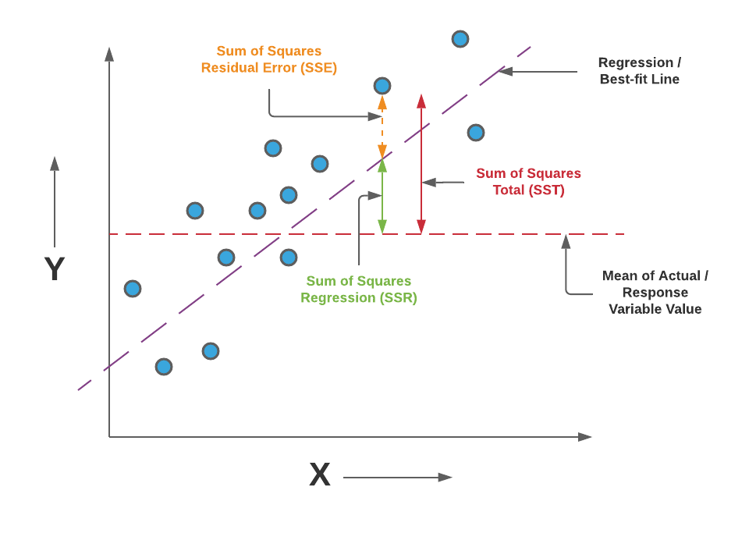
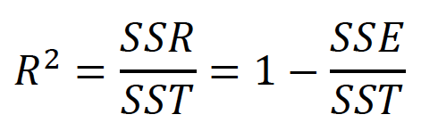
Criteria for model selection
𝑅² Criterion the multiple coefficient of determination
R² will increase when independent variables are added to the model. Therefore, the model that includes all 𝑝 independent variables 𝐸(𝑌)=𝛽₀+𝛽₁𝑋₁+𝛽₂𝑋₂+...+𝛽_{𝑝}𝑋_{𝑝} will yield the largest 𝑅².
24

Slide 25
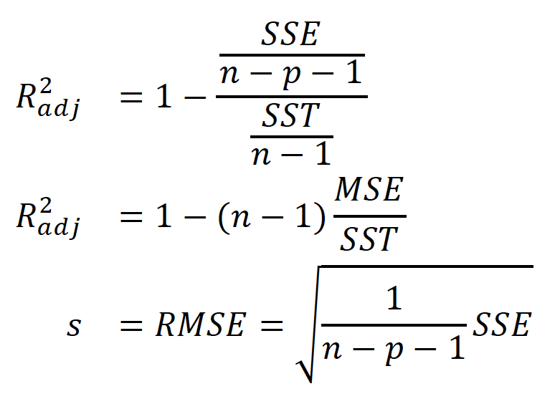
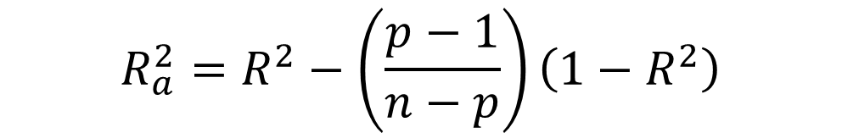
RMSE or Adjusted R²
Adjusted 𝑅² or RMSE Criterion
n: samples size, p: # of predictors
$$R_{a}^{2}=R^{2}−\left(\frac{p−1}{n−p}\right)\left(1−R^{2}\right)$$
25

Slide 26
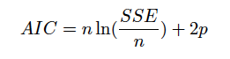
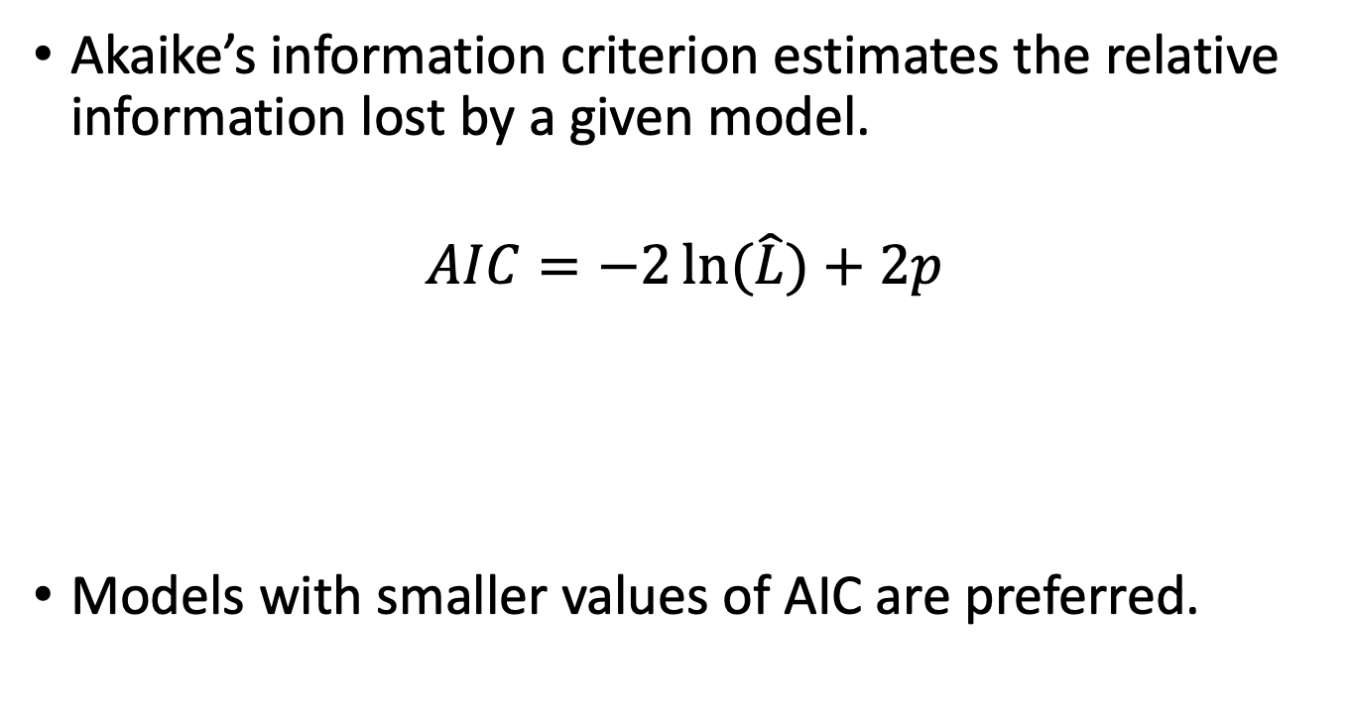
AIC (Akaike’s information criterion)
Akaike’s information criterion estimates the relative information lost by a given model.
$$AIC=−2\ln{(\hat{L})}+2p$$
Models with smaller values of AIC are preferred.
26

Slide 27
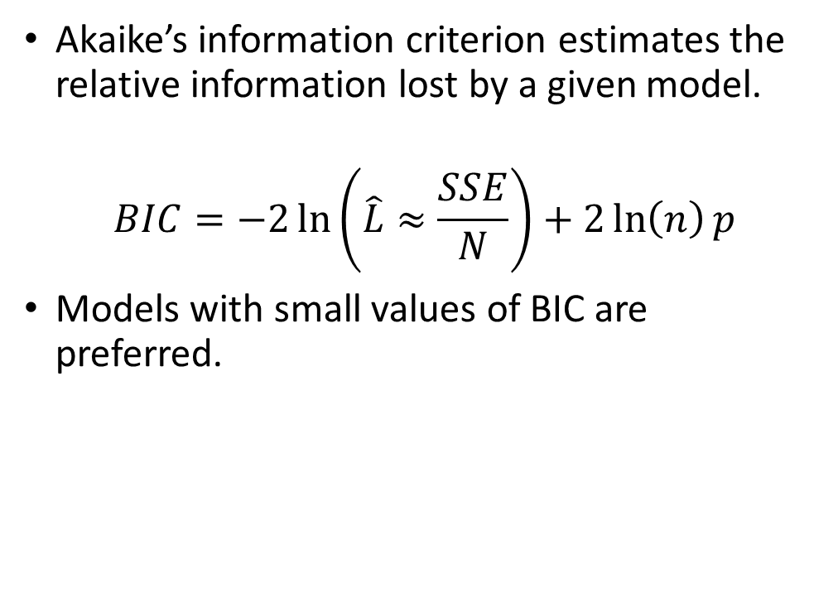
BIC (Bayesian information criterion)
Akaike’s information criterion estimates the relative information lost by a given model.
$$BIC=−2\ln\left(\hat{L}≈\frac{SSE}{N}\right)+2\ln\left(n\right)p$$
Models with small values of BIC are preferred.
27

Slide 28
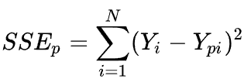
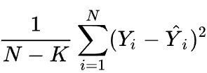
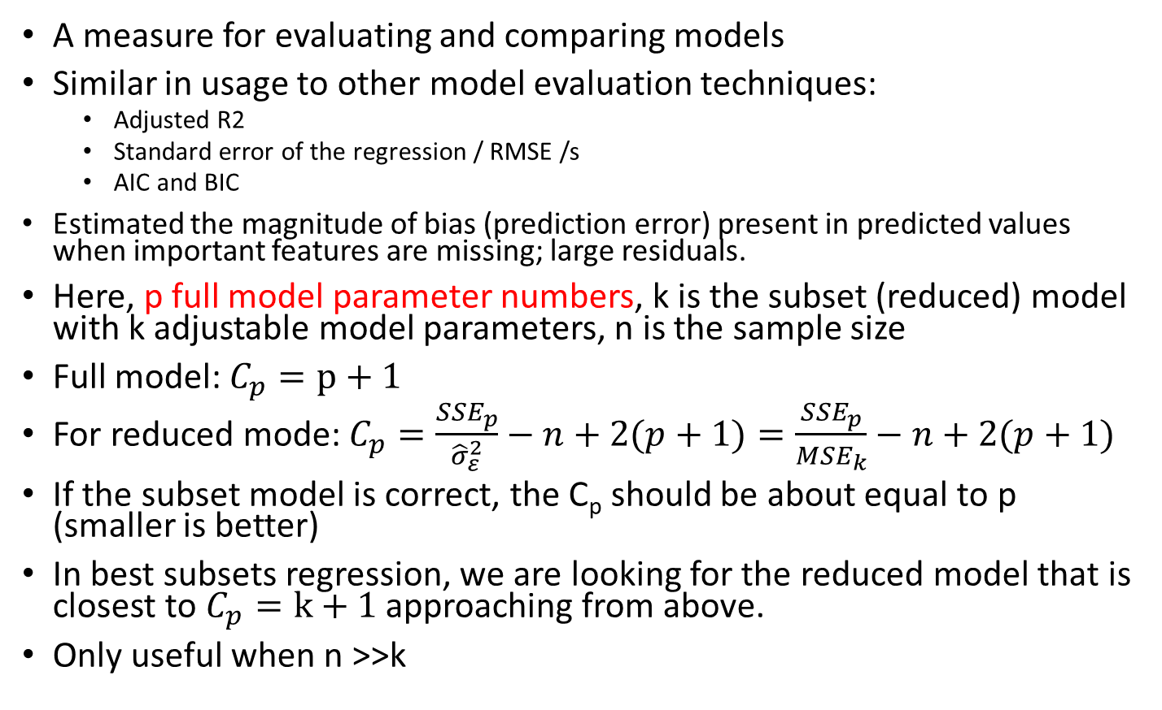
Mallows’s C_{p} Criterion
A measure for evaluating and comparing models
Similar in usage to other model evaluation techniques:
Adjusted R2
Standard error of the regression / RMSE /s
AIC and BIC
Estimated the magnitude of bias (prediction error) present in predicted values when important features are missing; large residuals.
Here, p full model parameter numbers, k is the subset (reduced) model with k adjustable model parameters, n is the sample size
Full model: $C_{p}=p+1$
For reduced mode: $C_{p}=\frac{{SSE}_{p}}{{\hat{σ}}_{ε}^{2}}−n+2(p+1)=\frac{{SSE}_{p}}{{MSE}_{k}}−n+2(p+1)$
If the subset model is correct, the C_{p} should be about equal to p (smaller is better)
In best subsets regression, we are looking for the reduced model that is closest to $C_{p}=k+1$ approaching from above.
Only useful when n >>k
MSEk=
28
Notes:
[https://online.stat.psu.edu/stat462/node/197/]
Using the C_{p} criterion to identify "best" models
Finally—we're getting to the moral of the story! Just a few final facts about Mallows' C_{p}-statistic will get us on our way. Recalling that k denotes the number of predictor terms in the model:
Subset models with small C_{p} values have a small estimated total (standardized) variation in predicted responses.
When the C_{p} value is ...
... near k+1, the bias is small (next to none)
... much greater than k+1, the bias is substantial
... below k+1, it is due to sampling error; interpret as no bias
For the largest model containing all of the candidate predictors, C_{p} = k+1 (always). Therefore, you shouldn't use C_{p} to evaluate the full model (the model containing all of the candiate predictors).
That all said, here's a reasonable strategy for using C_{p} to identify "best" models:
Identify subsets of predictors for which the C_{p} value is near k+1 (if possible).
The full model always yields C_{p} = k+1, so don't select the full model based on C_{p}.
If all models, except the full model, yield a large C_{p} not near k+1, it suggests some important predictor(s) are missing from the analysis. In this case, we are well-advised to identify the predictors that are missing!
If a number of models have C_{p} near k+1, choose the model with the smallest C_{p} value, thereby insuring that the combination of the bias and the variance is at a minimum.
When more than one model has a small value of C_{p} value near k+1, in general, choose the simpler model or the model that meets your research needs.

Slide 29
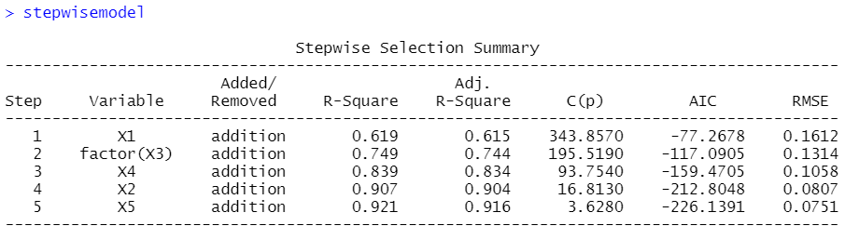
Combos 5
#Construct a table for combos 5
library(olsrr)
salary=read.csv("EXECSAL2.csv", header = TRUE)
firstordermodel<-lm(Y~X1+X2+X3+X4+X5+X6+X7+X8+X9+X10, data= salary)
#Select the subset of predictors that do the best at meeting some well-defined objective criterion, such
ks=ols_step_backward_p(firstordermodel, details=TRUE)
# for the output interpretation
R2<-c(ks$rsquare)
AdjustedR2<-c(ks$adjr)
Cp<-c(ks$cp)
AIC<-c(ks$aic)
RMSE<-c(ks$rmse)
cbind(R2, AdjustedR2,Cp,AIC, RMSE)
Combos 5 | R2 (+) | Adjusted R2 (+) | Cp (k+1) | AIC/BIC (-) | RMSE (-)
Model1
…
Model5

Slide 30
In class Practice Problem 13
Use the CREDIT.CSV data.
From the credit card example, using the All Possible Regressions Selection Criteria (combo5) to analyze which independent predictors should be used in the model.
Hints: construct combos 5 tables for the best models you get from problem 11, 12 and make a final decision.
Lecture_4.R
30

Slide 31
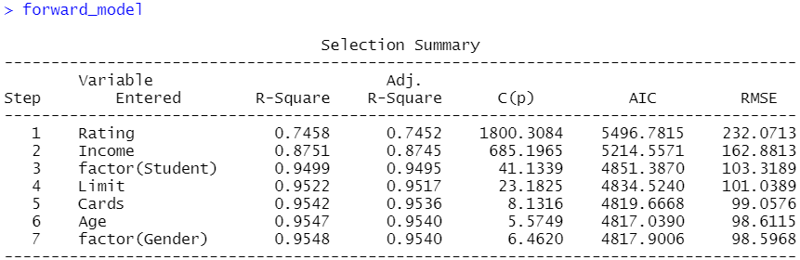
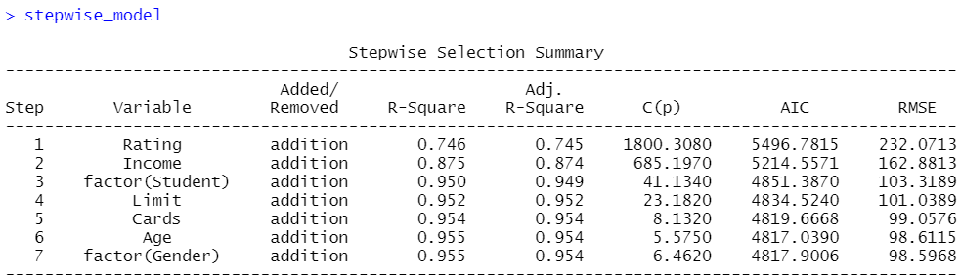
In class Practice Problem 13 Answers
Lecture_4.R
31

Slide 32
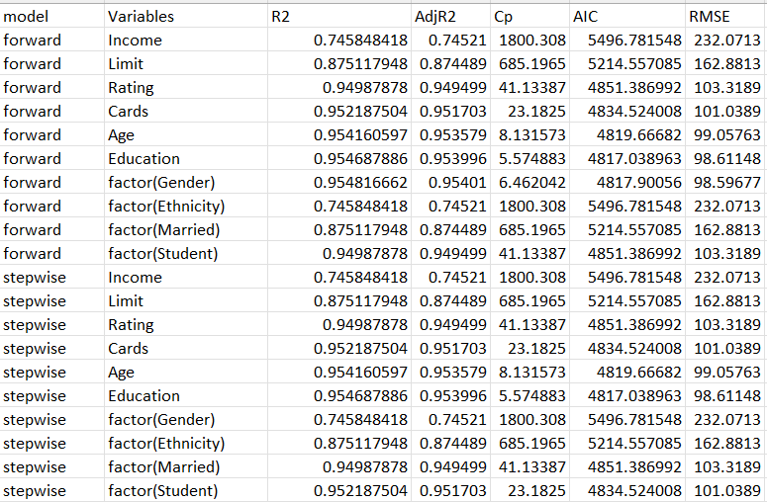
In class Practice Problem 13 Answers
Pros:
Cons:
The model's performance in relation to all predictors is evident.
Not dynamically displaying how predictors are added or deleted.
Lecture_4.R
32

Slide 33

Take away messages
Statistics:
Backward elimination
Forward selection
Stepwise regression
All Possible Regressions Selection Procedure (makes your own selection criteria combo)
Code:
lm(); anova();
ols_step_backward_p
ols_step_forward_p
ols_step_both_p
rbind(); cbind(); colnames(); write.csv(); getwd()

Slide 34

Thank you
Questions OR Comments?
Slack channel: section2-course-documents
Email: qing.li2@uclagary.ca

